Slide 1
GraphRAG
GraphRAG is a powerful retrieval mechanism that improves GenAI applications by taking advantage of the rich context in graph data structures.
Enterprise GenAI systems face a critical challenge:
the need for trustworthy and reliable results.
Pure large language model (LLM)-based solutions often fall short in this regard.
These models are trained to prioritize helpfulness over factuality, and their pre-training data usually lacks crucial recent and relevant information.
Consequently, they are prone to generating hallucinations of facts and explanations, which is particularly damaging in high-value business domains and use cases.
To address these issues, Retrieval-Augmented Generation (RAG) architectures have emerged as a solution.

Slide 2
RAG
RAG improves the reliability of GenAI components by ensuring that LLM answers are based only on accurate information from existing knowledge sources.
Basic RAG systems rely solely on semantic search in vector databases to retrieve and rank sets of isolated text fragments.
While this approach can surface some relevant information, it fails to capture the context connecting these pieces.
For this reason, basic RAG systems are ill-equipped to answer complex, multi-hop questions.
This is where GraphRAG comes in.

Slide 3
Graph retrievers can provide more accurate & relevant results
It uses knowledge graphs to represent and connect information to capture not only more data points but also their relationships.
Thus, graph-based retrievers can provide more accurate and relevant results by uncovering hidden connections that aren’t often obvious but are crucial for correlating information.
In this lecture, we’ll dive into how GraphRAG works, explore its advantages over other RAG architectures in improving answer quality and explainability, and demonstrate its practical application using a Neo4j example.

Slide 4
Three key phases of RAG:
Retrieval
Augmentation
Generation

Slide 5
Retrieval
In this phase, the RAG system retrieves relevant information from external data sources, such as documents or databases, based on the user’s query.
The retrieval process can use different techniques to identify the most pertinent data, such as similarity searches or database queries.
The results are then ranked and scored based on their relevance to the query.

Slide 6
Augmentation
During the augmentation phase, the retrieved information is combined with the original user question, along with any additional instructions or context.
This augmented prompt provides a richer context for the language model to generate a response.
The goal is to force the model to only use this relevant information to produce an accurate and useful output.

Slide 7
Generation
In the final phase, the augmented prompt is processed by an LLM, which generates an answer in a requested format using only the provided context rather than relying on its pre-trained knowledge.
The response can also link source information and additional metadata.

Slide 8
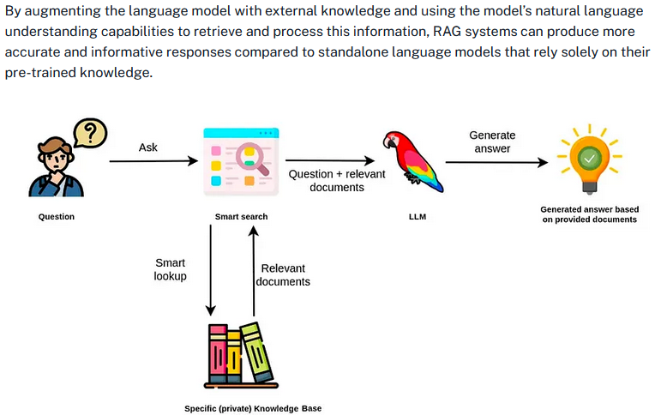

Slide 9
Limitations of Vector-Only RAG
Many baseline RAG systems rely solely on vector search over text embeddings (numerical vector representations) for information retrieval.
To accurately capture the cohesive semantic meaning of a piece of text, the source documents are often chunked into smaller fragments, which are then embedded, indexed, and stored for retrieval.
However, this approach has its limitations.
By relying solely on vector search, the response’s content is confined to the text fragments in the retrieved chunks.
This can lead to incomplete or fragmented answers.

Slide 10
RAG system might retrieve chunks
For example, if a user asks a question about a specific product feature, a vector-only RAG system might retrieve chunks that mention the product but fail to include relevant information from other parts of the documentation that provide a more comprehensive answer.
Moreover, due to the black-box nature of vector representations and vector search, such methods cannot explain the sources of the gathered information.
This means that users and developers have limited visibility into why certain chunks were retrieved and how they contribute to the generated response.
This lack of explainability can be a significant drawback, particularly in domains where transparency & accountability are crucial, such as healthcare or finance.

Slide 11
GraphRAG is a common approach to enhance retrieval
To address these shortcomings, new techniques are emerging to improve different phases of the RAG process (retrieval, augmentation, and generation).
Since the information provided to the LLM is crucial to answer quality, improving the retrieval mechanism often has the most significant impact.
GraphRAG is a common approach to enhance retrieval by incorporating structured domain knowledge stored in a knowledge graph.
By tapping into the rich connections and semantic relationships in a knowledge graph, GraphRAG aims to overcome the limitations of vector-only RAG and provide more accurate and explainable responses.

Slide 12
Knowledge Graph for Data Representation
A knowledge graph model is especially suitable for representing structured and unstructured data with connected elements.
Unlike traditional databases, they don’t require a rigid schema but are more flexible in the data model.
The graph model allows efficient storage, management, querying, and processing of the richness of real-world information.
In a RAG system, the knowledge graph serves as the flexible memory companion to the language skills of LLMs, such as summarization, translation, and extraction.

Slide 13
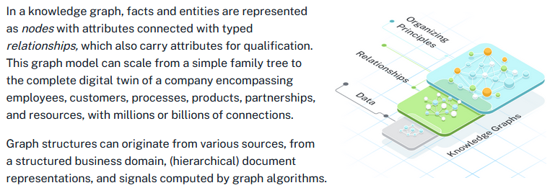

Slide 14
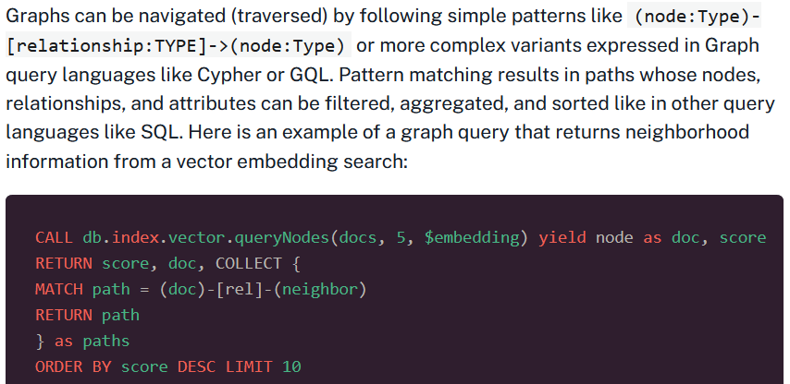
Graph Querying for GraphRAG Retrievers

Slide 15
How GraphRAG Improves Retrieval
A GraphRAG retrieval can find starting points in this network of data via vector, fulltext, spatial, or other searches and then follow relevant relationships to gather additional information to satisfy the user queries.
The context of the user and task is considered to increase relevance.
All captured nodes, relationships and their attributes can be filtered and ranked before being returned as context in the augmentation phase.

Slide 16
Several advantages over vector-only RAG systems:
By navigating the graph structure and following relevant relationships, GraphRAG can retrieve information that may not be directly mentioned in the initial set of retrieved chunks, providing a more comprehensive and contextually relevant response.
The ability to filter and rank the retrieved information based on the user’s context and task allows GraphRAG to prioritize the most pertinent information, improving the overall quality of the generated response.
GraphRAG enables better explainability by capturing the relationships between the retrieved information, making it easier to trace the sources and reasoning behind the generated response.
By using the knowledge graph’s ability to integrate structured and unstructured data, as well as computed signals, GraphRAG can provide more informed and nuanced responses that draw from a wider range of information sources.

Slide 17
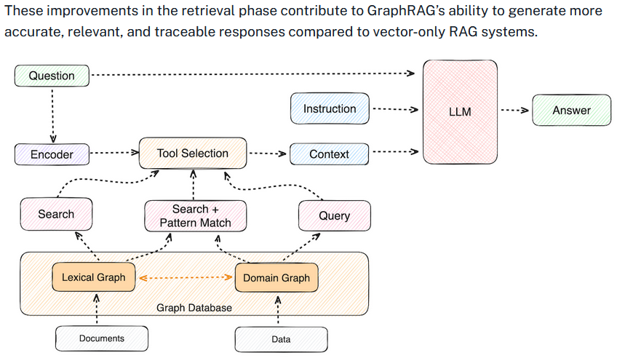

Slide 18
Types of GraphRAG Retrievers
The actual graph retrieval depends on the use case and domain.
Different types of retrievers can be combined, and their results ranked, combined, or sequenced.
In an agentic setup, retrievers can become tools that the LLM selects and runs iteratively, passing parameters and results until the necessary information to answer the question is collected.

Slide 19
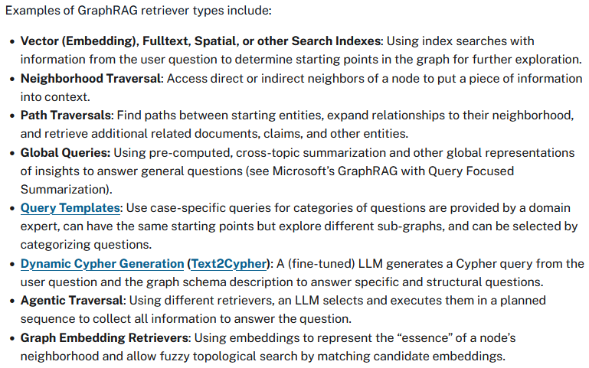

Slide 20
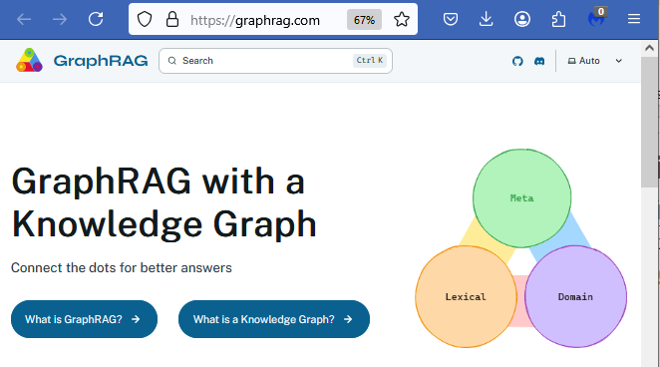
GraphRAG Pattern Catalog
You can find more examples in the GraphRAG Pattern Catalog on
https://graphrag.com

Slide 21
Knowledge Graph Construction
For GraphRAG to work well, we need to ensure that our data has a shape that accurately represents the highly relevant, connected pieces of information.
To create this knowledge graph, we need to follow two steps, which can be repeated for refinement:
Model the relevant nodes and relationships to represent our domain data.
Import, create, or compute the graph structures to fit this graph model.

Slide 22
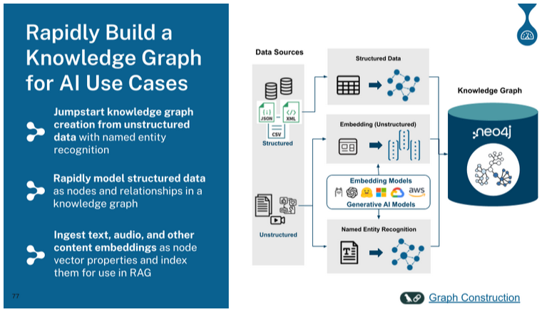

Slide 23
We can combine different sources of data:
Import existing structured data from databases, files or APIs.
Turn unstructured data (text, audio, video) into a graph representation of document structures/hierarchies and add vector embeddings and full-text indexes for chunks.
Construct or connect structured entities (with optional embeddings) and their relationships from textual information.
Enhance existing graphs with additional computation or algorithms, such as topic-clustering summaries (like in Microsoft Query Focused Summarization), similarity relationships, and personalized page rank (PPR) scores.

Slide 24
A GraphRAG Example With Neo4j
A frequent use case for GraphRAG is analyzing research information in more detail than just “chatting with your PDF.”
In a vector-only semantic search approach, the data returned from the retrievers are just scored chunks of text with little or no information on how they relate to concepts from the domain or each other.
In contrast, a GraphRAG approach allows us to extract entities such as Person, Organization, Article, Paper, BiologicalProcess, Condition, Disease, Drug, Gene, Expression, Exposure, and Pathway that appear in our documents and create a rich network of information.
To demonstrate this, let’s walk through an example of constructing a knowledge graph using the open source neo4j-graphrag package.
You can also use LangChain, LlamaIndex, or other integrations.

Slide 25
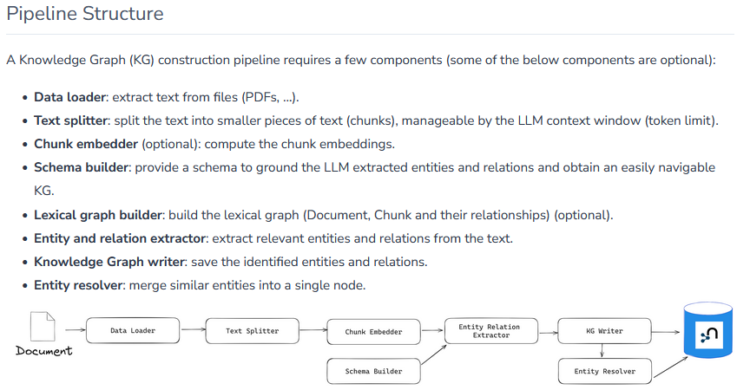
In this example, we use the SimpleKGPipeline

Slide 26
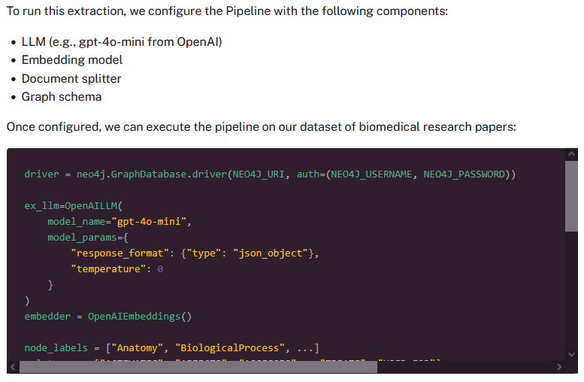

Slide 27
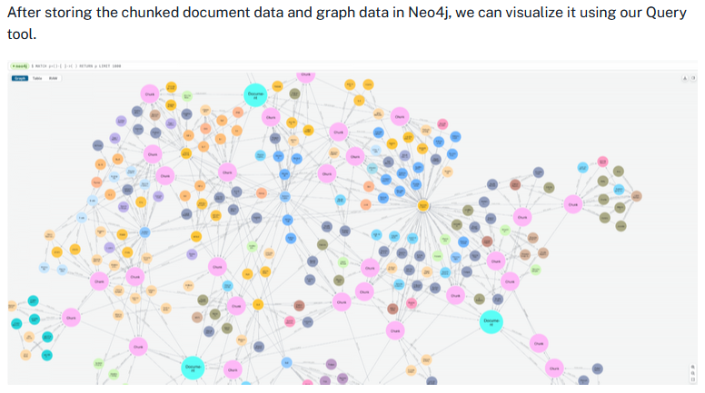

Slide 28
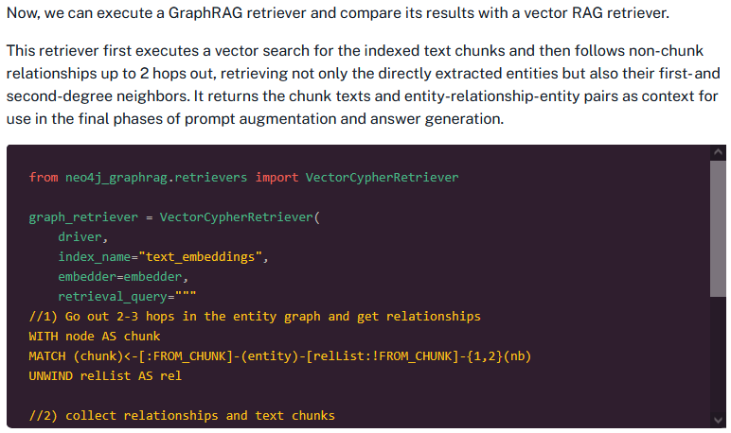

Slide 29
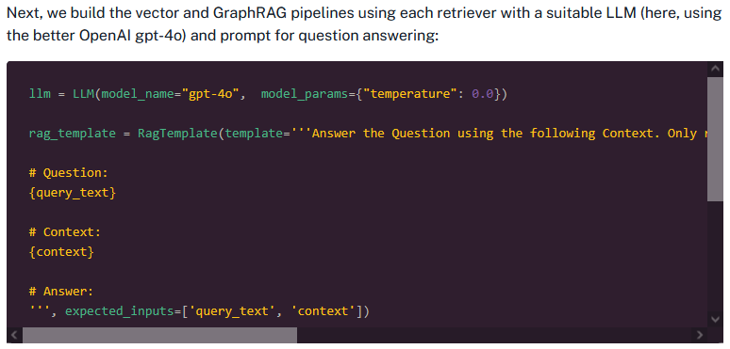

Slide 30
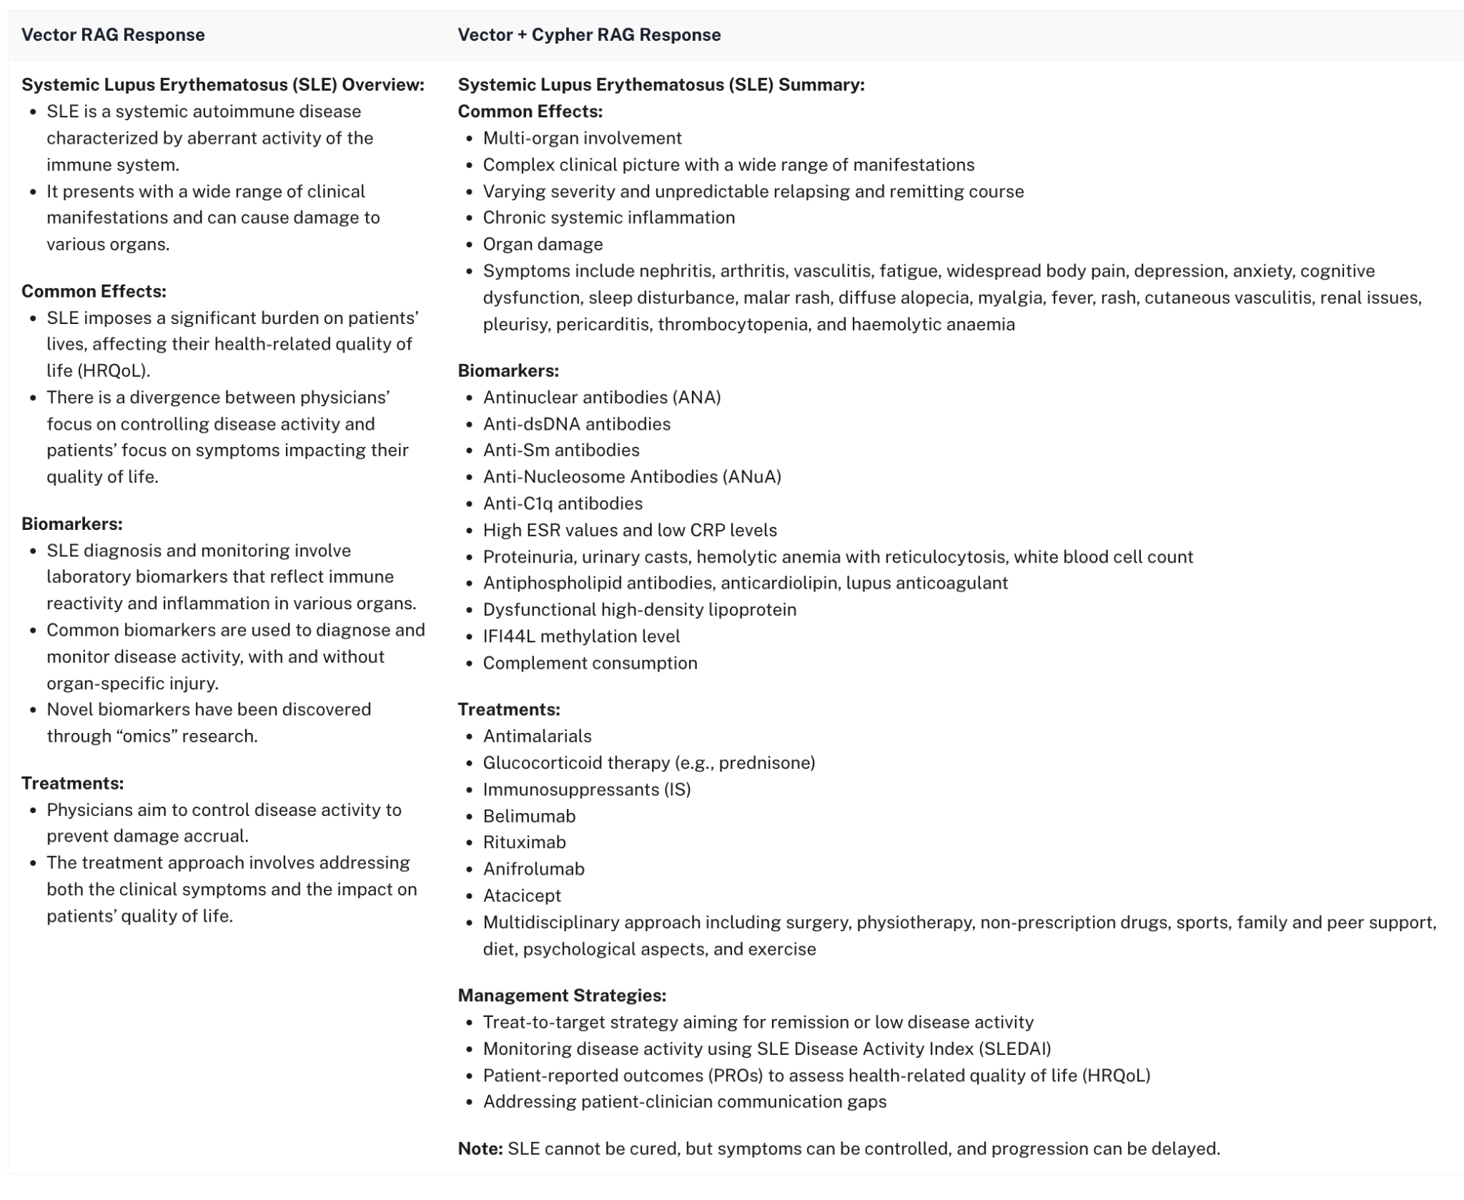
Comparison of answers shows the GraphRAG response is much more comprehensive & covers more of the relevant context

Slide 31
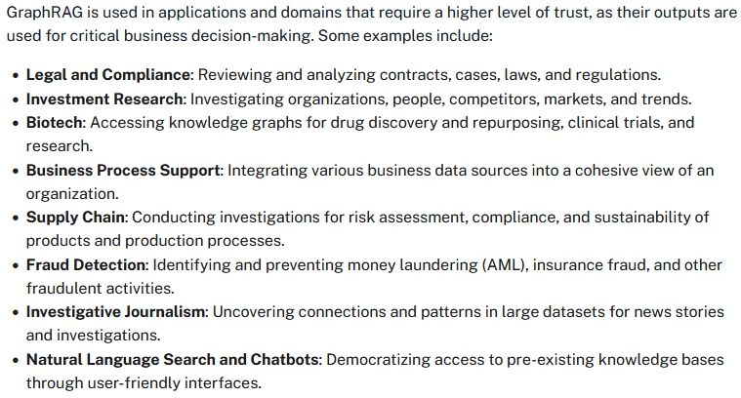
Common GraphRAG Use Cases

Slide 32
GraphRAG: Enabling Enterprise-Grade AI Apps
RAG architectures are currently the most effective way to provide reliable content for GenAI applications by using data from trusted data sources.
GraphRAG takes this a step further, improving upon basic vector-based RAG in both quality and explainability.
By considering more relevant context and using a variety of retrievers that navigate document, domain, and computed graph structures, GraphRAG delivers more accurate, trustworthy, and traceable results.
The combination of knowledge graphs, with their rich representation of real-world information, and LLMs, with their advanced language skills, creates a robust and reliable solution for enterprise use cases.
As more organizations adopt GenAI, GraphRAG will be essential in ensuring the accuracy, reliability, and transparency of these systems, paving the way for better decision-making & improved business outcomes.

